Slide 1
Geometry-Informed Graph Neural Operator for Speeding Up CFD-Based Vehicle Aerodynamic Analysis
Name : Surendar Baskaran
Roll No : CH24M576
Mentors: Tanmay Santra,Rajib Dutta

Slide 2
Introduction/ Motivation
CFD simulations are accurate but extremely computationally expensive (hours per geometry).
Complex 3D aircraft like BWB exhibit nonlinear aerodynamic interactions.
Need for fast, generalizable surrogate models for surface-pressure and aerodynamic coefficients.
Neural Operators + Geometric Deep Learning offer near real-time aerodynamic prediction.
Why This Problem Matters
Need a method that captures both:
Local geometric features (edges, curvature)
Global aerodynamic interactions (wake, lift distribution)

Slide 3
Literature Survey
Existing Approaches:
ROMs (POD/Kriging): Fast but fail on nonlinear 3D flows.
CNN-based models: Grid-dependent, unsuitable for arbitrary aircraft geometries.
PointNet / PointNet++: Good for global metrics; poor for Cp distribution.
MeshGraphNets: Strong local mesh reasoning; limited global flow capture.
Neural Operators (FNO/GNO/GINO): Excellent global modeling; no prior use on aircraft surface-only data.
No work combines geometry-aware GNN + neural operators for surface-only BWB aerodynamic prediction.

Slide 4
Problem Statement :
Predict surface pressure distribution (Cp) and aerodynamic coefficients CL, CD.
Using only surface mesh geometry of BWB aircraft
Learn a function-to-function aerodynamic operator
Ensure generalization to unseen geometries
Enable rapid inference without full CFD runs

Slide 5
Proposed Architecture (GA-GNO)
Input Geometry:
• Surface mesh (V, E)
• Node features:
coords, normals, curvature
Graph Encoder:
Local kernel on mesh
Message passing to capture curvature, edges, local topology
Latent Grid Mapper:
Projects irregular mesh → structured latent grid
Enables global ops
Graph Decoder:
Interpolates latent grid predictions back to surface mesh
Outputs Cp at nodes
Spectral Operator (FNO ) Block :
Fourier convolution
Captures global flow
interactions: wake, pressure recovery
Aerodynamic Outputs:
Surface Cp field
CL, CD via integration

Slide 6
Methodology Pipeline:
Model Training (GA-GNO):
Graph encoder learns local geometry features.
Latent grid + spectral operator for globals.
Decoder reconstructs Cp on mesh.
Loss: Cp error + CL/CD error.
Optimizer: Adam, early stopping
Data Preparation :
Load BlendedNet geometries
Compute node features (coords, normals, k)
Build graph structure (V, E)
Train–Test Split :
Leave-one-geometry-type-out evaluation.
Unseen geometry sets reserved for testing.
Ensures generalization assessment
Final Evaluation :
Compare accuracy, generalization, speed.
Measure GPU memory & inference time.
Highlight generalization to unseen shapes. Quantify speedup vs CFD and baselines
Baseline Benchmarking :
Retrain MeshGraphNets, PointNet++, FNO/GNO on BlendedNet for a fair comparison.
Use identical data splits & preprocessing
Validation & Error Analysis :
Evaluate Cp field accuracy (L2, RMSE).
Measure coefficient errors (CL, CD).
Visualize error maps & distribution

Slide 7
Benchmarking Strategy
No baseline models exist for BlendedNet → retraining required
Baselines to retrain:
MeshGraphNets
PointNet / PointNet++
FNO / GNO
All baselines trained with identical:
Preprocessing
Train/validation split
Geometry hold-out protocol
Metrics: L2 error, RMSE, CL/CD error, inference time, GPU memory

Slide 8
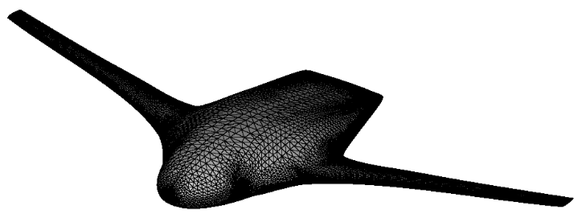
Dataset :
BlendedNet (2025)
999+ BWB aircraft geometries
Surface-only pressure coefficients (Cp)
Variation in sweep, taper, camber, twist
Mesh size: ~100k–300k nodes per geometry
Ideal for operator learning (consistent mesh topology, high geometric diversity)

Slide 9
Expected Results / Simulation Plan
Cp field prediction within low L2 error
Accurate lift & drag coefficients
Speedup: hundreds to thousands × faster than CFD
Baseline comparison expected to show:
GA-GNO > PointNet (for field prediction)
GA-GNO > MeshGraphNet (for global flow capture)
GA-GNO ~ GINO performance but surface-only, lower computation

Slide 10
Conclusion & Future Work
Conclusion:
Developed a geometry-aware neural operator for BWB aerodynamics
Integrates local GNN reasoning + global spectral operators
Enables fast, accurate, surface-only aerodynamic prediction
Meets scalability and generalization requirements

